Slide 1
Prisoner’s Dilemma
Game Theory
By Maaz Malik

Slide 2

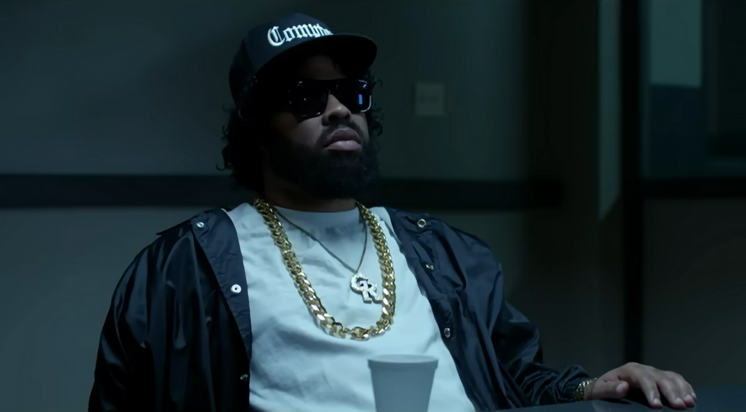
``Snitch on your partner,
and you go free``
``If your partner snitches on you, you go to jail``

Slide 3
``However, if both of you
snitch, both go to jail for
3 years
``Shall yall choose to
stay silent, 1 year``

Slide 4
PAYOFF MATRIX
PARTNER 1
YEARS IN JAIL | STAY SILENT | SNITCH
STAY SILENT | 1, 1 | 5, 0
SNITCH | 0, 5 | 3, 3
PARTNER 2
NASH
EQUILLIBRIUM

Slide 5
PAYOFF MATRIX
PARTNER 1
YEARS IN JAIL | STAY SILENT | SNITCH
STAY SILENT | 1, 1 | 5, 0
SNITCH | 0, 5 | 3, 3
PARTNER 2
NASH
EQUILLIBRIUM

Slide 6
PAYOFF MATRIX
PARTNER 1
YEARS IN JAIL | STAY SILENT | SNITCH
STAY SILENT | 1, 1 | 5, 0
SNITCH | 0, 5 | 3, 3
PARTNER 2
NASH
EQUILLIBRIUM

Slide 7

Split Or Steal
Mr Beast

Slide 8



Black or Pink
Andha Pyaar

Slide 9


Slide 10



Arms Races, Environmental Degradation, or Trade Conflicts

Slide 11
Cold War 1940-80

Slide 12
Trade War 2018-Present

Slide 13
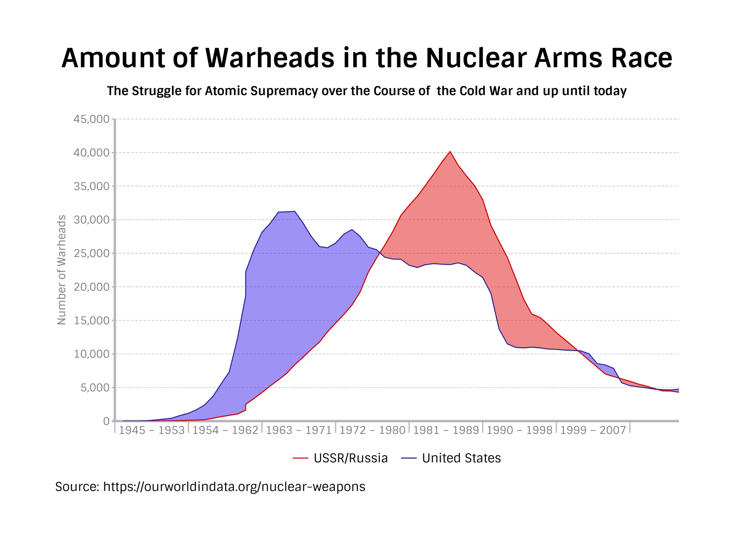
Rational
Agents
Decided
To
Cooperate

Slide 14


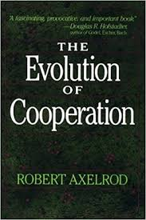
Robert
Axelrod

Slide 15
Observation 1
“NICE`` Strategies Outperformed “DEVIOUS” ones

Slide 16
Observation 2
“RETALIATORY`` Strategies performed continuously
better

Slide 17
Observation 3
“FORGIVING`` Strategies Outperformed “GRUDGED” ones

Slide 18

?

Slide 20
Thank you

